Slide 1
21st Century Scenarios of Hourly Climate/Weather and Hourly Electricity Demand for Power Grid Modeling
Jennie Rice, IM3 Principal Investigator (PNNL), Andrew Jones (LBNL), Casey Burleyson (PNNL), Casey McGrath (PNNL), Aowabin Rahman (PNNL), Deeksha Rastogi (ORNL), Pouya Vahmani (LBNL)
jennie.rice@pnnl.gov

Slide 2
4 Alternative Climate Futures (2020-2099): Hourly temperature, humidity, solar radiation, etc. at ~7mi²
Example results: Heatwave Intensification
Historic baseline reproduces observed sequence of past events (1980-2019)
Two future periods repeat the sequence of past events with thermodynamic warming signal drawn from “hotter” and “cooler” global circulation models (GCMs) (2020-2059; 2060-2099)
Dynamical downscaling through the Weather Research Forecasting (WRF) model ensures physical consistency among variables
1/8 deg (~7 mi²) resolution; 25 hourly and over 250 three-hourly variables
Jones et al. in prep;
https://tgw-data.msdlive.org/

Slide 3
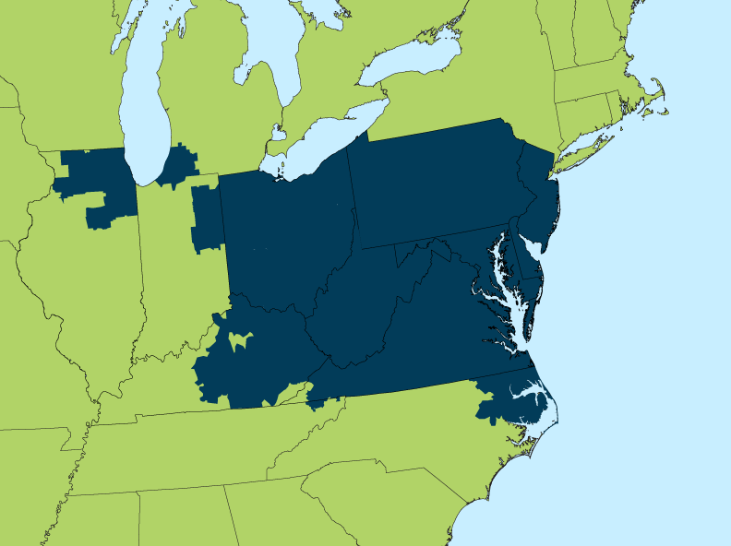
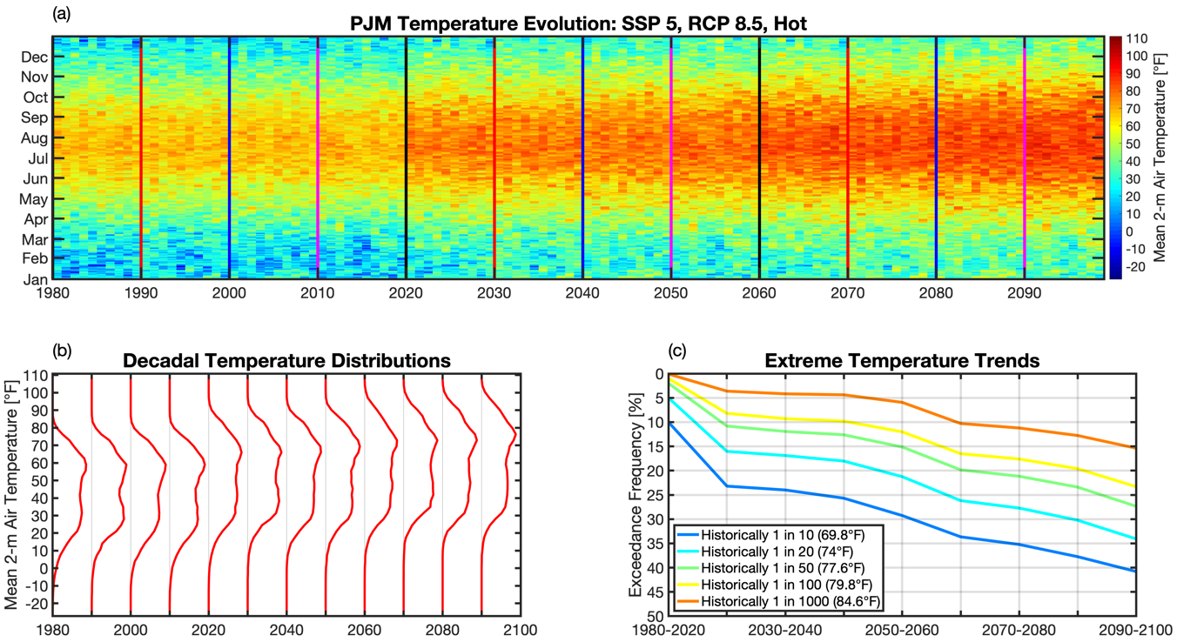
High Resolution Climate Projections For Electricity Grid Modeling
Example: Analysis of 21st century hourly temperatures in the PJM Balancing Authority for the SSP5-RCP8.5 scenario combination
PJM BA
Climate data preparation for electricity grid stress modeling:
Hourly WRF output is first spatially-averaged by county in the CONUS
County-level hourly values are then population-weighted (consistent with SSP) to create annual 8760-hr meteorology time series for each Balancing Authority (BA)
2100
2100
Burleyson et al. in prep

Slide 4
Projecting Weather-Driven Hourly Electricity Demands: TELL Model Overview
Projects the evolution of hourly electricity demand in response to changes in weather and climate.
Designed to provide hourly loads for grid operations models.
Based on a series multilayer perceptron models trained on historical (2015-2019) loads and meteorology.
Output is hourly, temperature-dependent projections of future electricity demand at the county-, state-, and BA-scale that are conceptually and quantitatively consistent with one another.
Future projections are scaled to match state-level, annual loads projected by GCAM-USA (global energy-economy model) that account for energy policy, population and GDP, building technology, and fuel price changes.
TELL is released as an extensively documented open-source code base: https://github.com/IMMM-SFA/tell
Example results by Balancing Authority and county
McGrath et al. in prep

Slide 5
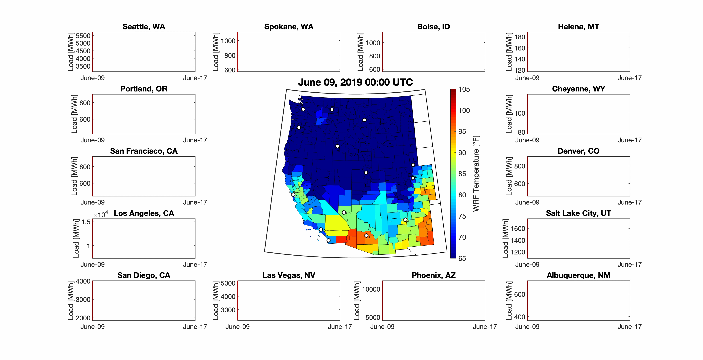
Hi-res Climate Data Used in the TELL Model to Simulate Electricity Demand at County Scale During a June Heat Wave
Click again to play the video!
Hourly county loads; plots are titled by the largest city in each county
Hourly population-weighted temperatures by county

Slide 6
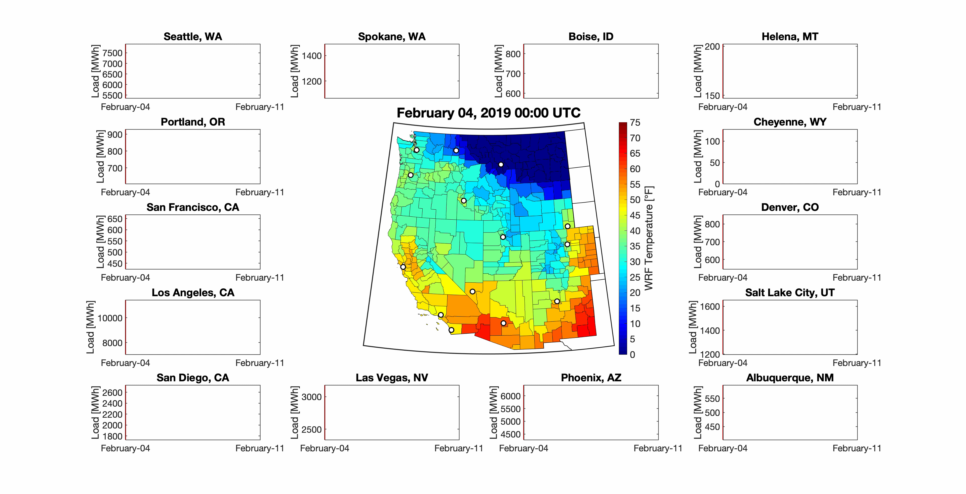
Hi-res Climate Data Used in the TELL model to Simulate Electricity Demand at County Scale During a February Cold Snap
Click again to play the video!
Hourly county loads; plots are titled by the largest city in each county
Hourly population-weighted temperatures by county

Slide 7
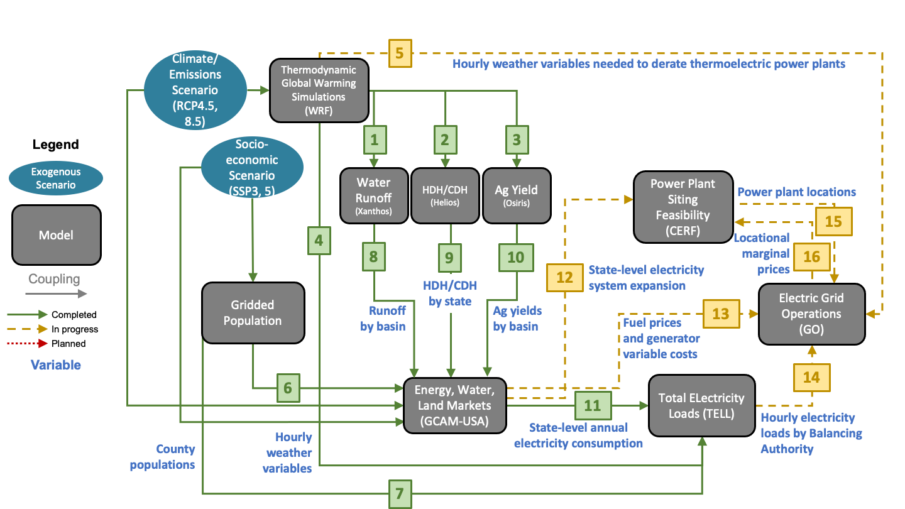
Ongoing, Open-Source Research Links National Energy Transitions With Future Climate Impacts on Electricity Demand, Supply Resources, Infrastructure, and Grid Operations to Understand Future Grid Stress
Initial research results available in Fall 2022

Slide 8
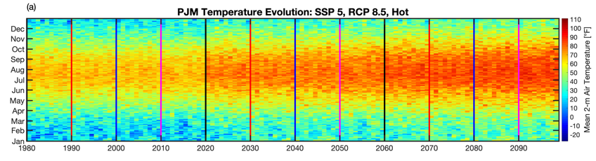
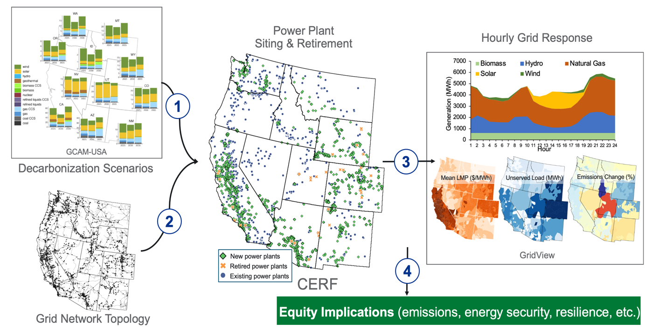
Grid Operations, Decarbonization, Environmental and Energy Equity Platform (GODEEEP)
Internal PNNL LDRD investment leverages IM3 research to develop first-ever linkage of national scale decarbonization scenarios to an industry grade operations model under extreme climate events and determine equity implications
Illustrative results, Campbell et al. in prep
Grid Model

Slide 9
Thank you!
jennie.rice@pnnl.gov

